Slide 1
Hidden Markov Model
Il-Chul Moon
Dept. of Industrial and Systems Engineering
KAIST
icmoon@kaist.ac.kr

Slide 2
Weekly Objectives
Learn hidden Markov model
  Transition from the static clustering to the dynamic clustering
  Understand the difference of the graphical model
Know and able to answer the three major questions of HMM
  Know how to solve the evaluation question
  Know how to solve the decoding question
  Know how to solve the learning question
Link to the previous lectures
  Link the forward-backward algorithm to the message passing
  Link the baum-welch algorithm to the EM algorithm

Slide 3
Viterbi decoding

Slide 4
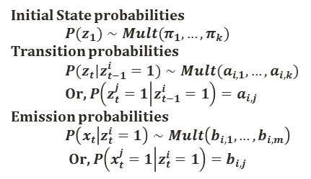
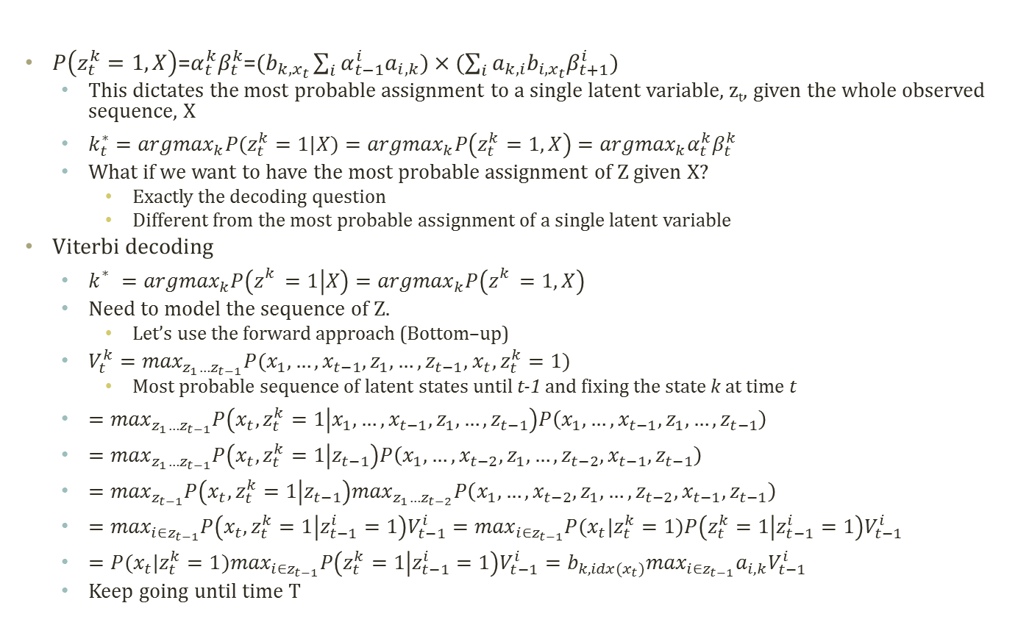
Viterbi Decoding
Initial State probabilities
  $$P(z_{1})∼Mult(π_{1},…,π_{k})$$
Transition probabilities
  $$P(z_{t}|z_{t−1}^{i}=1)∼Mult(a_{i,1},…,a_{i,k})$$
  Or, $P\left(z_{t}^{j}=1 | z_{t−1}^{i}=1\right)=a_{i,j}$
Emission probabilities
  $$P\left(x_{t} | z_{t}^{i}=1\right)∼Mult\left(b_{i,1},…,b_{i,m}\right)$$
  Or, $P\left(x_{t}^{j}=1 | z_{t}^{i}=1\right)=b_{i,j}$
$P\left(z_{t}^{k}=1,X\right)$=$α_{t}^{k}β_{t}^{k}$=$(b_{k,x_{t}}\sum_{i}{α_{t−1}^{i}a_{i,k}})×(\sum_{i}{a_{k,i}b_{i,x_{t}}β_{t+1}^{i}})$
  This dictates the most probable assignment to a single latent variable, z_{t}, given the whole observed sequence, X
  $k_{t}^{∗}={argmax}_{k}P(z_{t}^{k}=1|X)={argmax}_{k}P\left(z_{t}^{k}=1,X\right)={argmax}_{k}α_{t}^{k}β_{t}^{k}$
  What if we want to have the most probable assignment of Z given X?
    Exactly the decoding question
    Different from the most probable assignment of a single latent variable
Viterbi decoding
  $k_{}^{∗}={argmax}_{k}P\left(z_{}^{k}=1 | X\right)={argmax}_{k}P\left(z_{}^{k}=1,X\right)$
  Need to model the sequence of Z.
    Let’s use the forward approach (Bottom–up)
  $V_{t}^{k}=\max_{z_{1}…z_{t−1}}P(x_{1},…,x_{t−1},z_{1},…,z_{t−1}$, $x_{t},z_{t}^{k}=1)$
    Most probable sequence of latent states until t-1 and fixing the state k at time t
  $=\max_{z_{1}…z_{t−1}}P\left(x_{t},z_{t}^{k}=1 | x_{1},…,x_{t−1},z_{1},…,z_{t−1}\right)P\left(x_{1},…,x_{t−1},z_{1},…,z_{t−1}\right)$
  $=\max_{z_{1}…z_{t−1}}P\left(x_{t},z_{t}^{k}=1 | z_{t−1}\right)P\left(x_{1},…,x_{t−2},z_{1},…,{z_{t−2},x}_{t−1},z_{t−1}\right)$
  $=\max_{z_{t−1}}P\left(x_{t},z_{t}^{k}=1 | z_{t−1}\right)\max_{z_{1}…z_{t−2}}P\left(x_{1},…,x_{t−2},z_{1},…,{z_{t−2},x}_{t−1},z_{t−1}\right)$
  $=\max_{i∈z_{t−1}}P\left(x_{t},z_{t}^{k}=1 | z_{t−1}^{i}=1\right)V_{t−1}^{i}=\max_{i∈z_{t−1}}P(x_{t}|z_{t}^{k}=1)P\left(z_{t}^{k}=1 | z_{t−1}^{i}=1\right)V_{t−1}^{i}$
  $=P(x_{t}|z_{t}^{k}=1)\max_{i∈z_{t−1}}P\left(z_{t}^{k}=1 | z_{t−1}^{i}=1\right)V_{t−1}^{i}=b_{k,idx(x_{t})}\max_{i∈z_{t−1}}a_{i,k}V_{t−1}^{i}$
  Keep going until time T

Slide 5
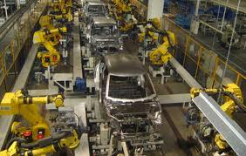
Detour: Assembly
Line Scheduling
Assembly Line 1
station S_{1,1}
station S_{1,2}
station S_{1,3}
station S_{1,4}
station S_{1,5}
station S_{1,6}
7
9
3
4
8
4
2
1
3
4
3
2
3
Production
Start
Production
End
2
1
2
2
1
4
2
8
5
6
4
5
7
station S_{2,1}
station S_{2,2}
station S_{2,3}
station S_{2,4}
station S_{2,5}
station S_{2,6}
Assembly Line 2
Time
Cost
Goal: Computing the fastest production route

Slide 6
Detour: Tracing Assembly Line Scheduling in DP
Assembly Line 1
station S_{1,1}
station S_{1,2}
station S_{1,3}
station S_{1,4}
station S_{1,5}
station S_{1,6}
7
9
3
4
8
4
2
1
3
4
3
2
3
Production
Start
Production
End
2
1
2
2
1
4
2
8
5
6
4
5
7
station S_{2,1}
station S_{2,2}
station S_{2,3}
station S_{2,4}
station S_{2,5}
station S_{2,6}
Assembly Line 2
Used for retrace purpose
Time | 1 | 2 | 3 | 4 | 5 | 6
L1 | 9 | 18 | 20 | 24 | 32 | 35
L2 | 12 | 16 | 22 | 25 | 30 | 37
Trace | 1 | 2 | 3 | 4 | 5 | 6
L1 | S | 1 | 2 | 1 | 1 | 2
L2 | S | 1 | 2 | 1 | 2 | 2

Slide 7
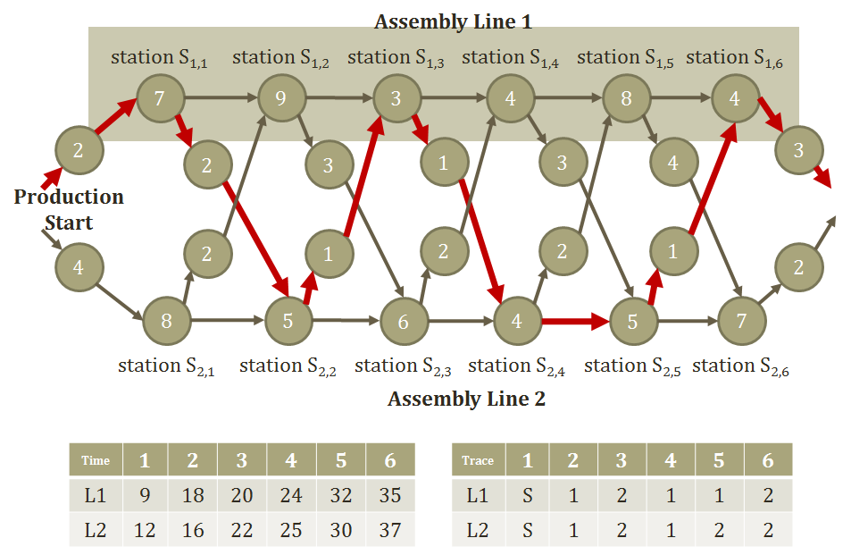

Viterbi Decoding
Algorithm
Need to know$V_{t}^{k}$
  Time X States
  Store $V_{t}^{k}$Two variables to store the trace and the
  probability up to time t: Two memoization tables
  Answering the decoding question with $π$, $a$, $b$, X
ViterbiDecodingAlgorithm
  Initialize
    $V_{1}^{k}=b_{k,x_{1}}π_{k}$
  Iterate until time T
    $V_{t}^{k}=b_{k,idx(x_{t})}\max_{i∈z_{t−1}}a_{i,k}V_{t−1}^{i}$
    ${trace}_{t}^{k}={argmax}_{i∈z_{t−1}}a_{i,k}V_{t−1}^{i}$
  Return $P\left(X,Z^{∗}\right)=\max_{k}V_{T}^{k}$, $z_{T}^{∗}={argmax}_{k}V_{T}^{k}$, $z_{t−1}^{∗}={trace}_{t}^{z_{t}^{∗}}$
Technical difficulties in the implemtation
  Very frequent underflow problems.
  Turn this into the log domain → from multiplication to summation

